Slide 1
Advanced Paratext Support
Companion Video Script — Recording Overview
Estimated runtime: 18-20 minutes
> Runtime target: ~60-75 seconds. Open on a talking-head or a simple title card — save the > screen recording for the first demo cue in Segment 1.
Notes:
Let's look at some advanced topics for Paratext supporters. In the first one, a team may wonder how to do something that seems like it ought to be simple, but they don't know how. And the answer is not immediately obvious.
In the other topics, a team you support may call you in a state of
alarm. Maybe their project history looks like someone's edit just got undone. Maybe a
team leader swears a change appeared under a name that shouldn't have had access to that
book. Maybe a translator tells you their notes — weeks of them — have simply vanished.
None of those are hypothetical. They're the exact five support calls a Paratext-using
consultant fielded, and they're the five situations this course prepares you to walk
into calmly, diagnose correctly, and fix without making things worse. That last part
matters: in a couple of these scenarios, the wrong first move — an instinctive
Send/Receive — is exactly what turns a recoverable problem into a real one. Let's go
through what you're actually looking at in each case, and what you do about it.

Slide 2
SEGMENT DIVIDER
Segment 1 — An editable copy of an open text (companion to Lesson 1)
~2.5 minutes.
4 on-screen cues follow — see subsequent slides for shot list and narration.

Slide 3
SEGMENT 1 · CUE 1 OF 4
On-screen
Screen recording: open a Paratext resource (e.g., a public-domain text like the Berean Standard Bible) and try clicking into the text to type. Nothing happens — it stays locked.
Notes:
"Here's the moment that confuses almost everyone the first time. This text is public domain. Surely you can edit it? You can't — not like this. A Paratext **resource** is read-only no matter what license the underlying text carries. That's not a bug; it's what a resource is."

Slide 4
SEGMENT 1 · CUE 2 OF 4
On-screen
Cut to a simple title card: The fix: bring it in as a project, not a resource.
Notes:
"If a team or a workshop needs an editable copy of an open text — to practice on, without any risk to their real translation draft — you don't unlock the resource. You get the text in USFM format from outside Paratext and bring it in as its own project."

Slide 5
SEGMENT 1 · CUE 3 OF 4
On-screen
Screen recording, live: main menu → New Project → set language in project properties → set project type to standard translation → Project menu → Manage Books → Import Books → select the downloaded USFM files.
Notes:
"Four moves: new project, set the language, set the type to standard translation — not a resource — and import the books. Two good places to find USFM downloads: ebible.org/find, and open.bible/bibles."

Slide 6
SEGMENT 1 · CUE 4 OF 4
On-screen
Title card: Same steps for Paratext 9 and earlier versions.
Notes:
"This distinction — locked resource versus editable project — hasn't changed across Paratext versions. If you've done this before in an older Paratext, nothing here is different."

Slide 7
SEGMENT DIVIDER
Segment 2 — Why project history can look "undone" (companion to Lesson 2)
~3.5 minutes. This is the most conceptually tricky segment — don't rush the version-number > explanation.
7 on-screen cues follow — see subsequent slides for shot list and narration.

Slide 8
SEGMENT 2 · CUE 1 OF 7
On-screen
Title card: Mercurial orders history by version number, not by clock time.
Notes:
"Underneath Paratext, the Mercurial engine that manages Send/Receive numbers every change: version 1, version 2, version 3. That's the whole mechanism behind what you're about to see."

Slide 9
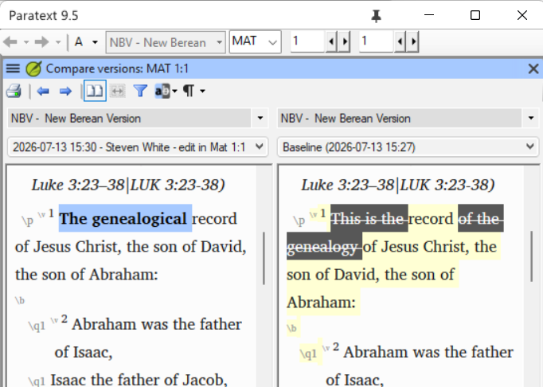
SEGMENT 2 · CUE 2 OF 7
On-screen
the edit made at the start of Matthew, with a point marked in project history.
image-4.png
Notes:
"Picture two translators, both starting from the same version — call it 18. One of them edits Matthew and marks a point in history."

Slide 10
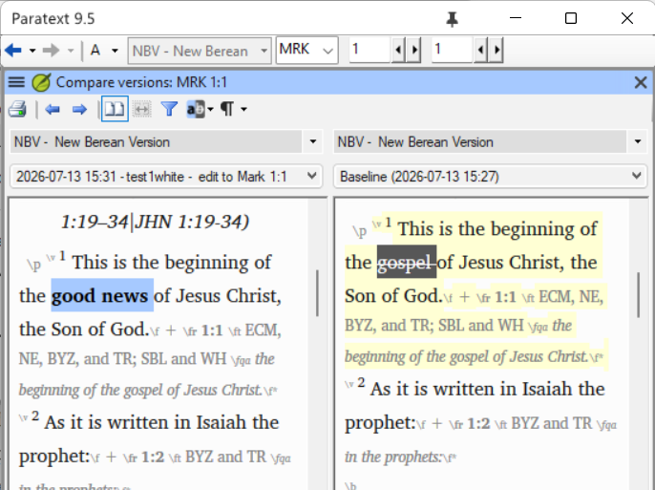
SEGMENT 2 · CUE 3 OF 7
On-screen
the edit made at the start of Mark, also marked in project history.
image-5.png
Notes:
"At the same time, the other edits Mark, from that same starting version, and also marks a point."

Slide 11
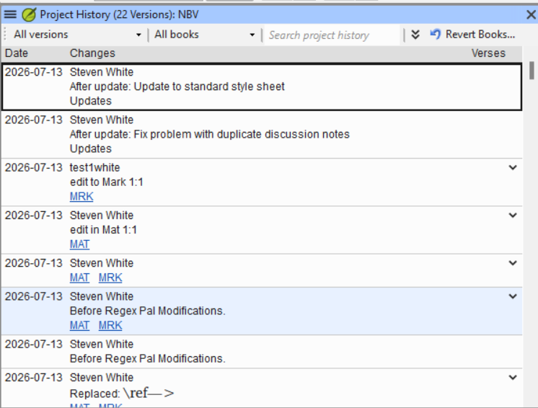
SEGMENT 2 · CUE 4 OF 7
On-screen
the merged project history after both users Send/Receive.
image-6.png
Notes:
"Both edits were meant to become 'version 19.' Mercurial can't allow two version 19s, so it picks one, renumbers the other to 20, and the merge becomes 21. The numbering is completely consistent — it's just not necessarily the order the edits actually happened in real time."

Slide 12
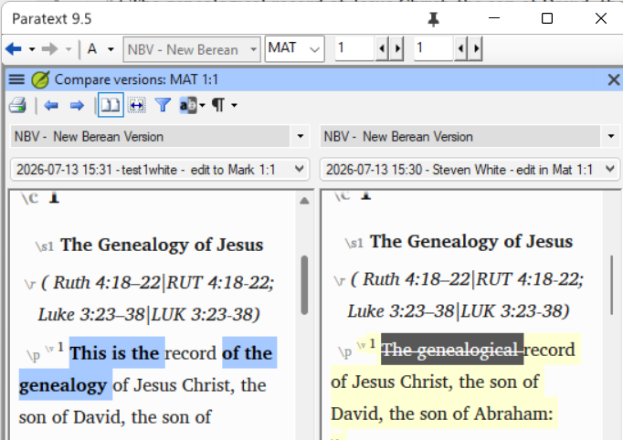
SEGMENT 2 · CUE 5 OF 7
On-screen
Compare Versions showing the Matthew edit appearing to be undone.
image.png
Notes:
"Now someone runs Compare Versions, checking the Matthew edit against the point where Mark was edited — and it looks like the Matthew edit vanished. It didn't. This is exactly the illusion the version-numbering mismatch creates. Nothing was lost."

Slide 13
SEGMENT 2 · CUE 6 OF 7
On-screen
Title card: A wrong system clock doesn't fool Mercurial.
Notes:
"One real case: a user's computer clock was months in the future. The timestamp looked newest, but Mercurial tracked the actual version sequence and knew that user's work wasn't really the most recent. It goes by version number, not the clock."

Slide 14
SEGMENT 2 · CUE 7 OF 7
On-screen
Title card: This has applied since Paratext 7.
Notes:
"None of this is new in Paratext 9 — it's been true of every Mercurial-based version, back to 7."

Slide 15
SEGMENT DIVIDER
Segment 3 — User roles are not a guarantee (companion to Lesson 3)
~3.5 minutes. This is a "here's the danger, here's the exact safe response" segment — > narrate the do-not-do step just as clearly as the do-this step.
6 on-screen cues follow — see subsequent slides for shot list and narration.

Slide 16
SEGMENT 3 · CUE 1 OF 6
On-screen
Title card: Paratext enforces edit access — only while you're inside Paratext.
Notes:
"A team leader once asked me: project history shows a change to a book, credited to someone who doesn't have editing rights to that book. Did they bypass the permissions? No. Paratext will never let someone edit through the program without the right role. But that protection only exists inside the program."

Slide 17
SEGMENT 3 · CUE 2 OF 6
On-screen
Title card, bulleted: hard drive corruption / file-system errors / Paratext crashing abnormally / computer crashing abnormally / Windows System Restore reverting .ptx files.
Notes:
"A book file can change outside Paratext entirely — corruption, a bad crash, or, if the project uses `.ptx` files, a Windows System Restore. Windows isn't supposed to touch user data, but Microsoft treats `.ptx` as a system file, so a restore can revert it anyway."

Slide 18
SEGMENT 3 · CUE 3 OF 6
On-screen
Title card: That change still goes out on the next Send/Receive — except for observers.
Notes:
"Whatever caused the change, Paratext still sends it to the rest of the team on the next Send/Receive, as if it were a normal edit. The one exception: an observer's local text changes are never sent, because they have no editing role to attribute a change to in the first place."

Slide 19
SEGMENT 3 · CUE 4 OF 6
On-screen
DANGER
DANGER title card, red or high-contrast: Do NOT Send/Receive right away.
Notes:
"Here's the part to say slowly and get right: if a user's computer or Paratext just crashed, or files are behaving strangely, the instinct to 'get back in sync' with an immediate Send/Receive is exactly the wrong move — it can push their corrupted files out to everyone else."

Slide 20
SEGMENT 3 · CUE 5 OF 6
On-screen
Screen recording, live: Delete project from that user's installation, then Send/Receive to pull a clean copy.
Notes:
"The safe response is two steps: delete the project from that user's Paratext, then Send/Receive to bring down a clean copy from the server. That gets them back to good without ever pushing the bad files out."

Slide 21
SEGMENT 3 · CUE 6 OF 6
On-screen
Title card: Applies to Paratext 9, 8, and 7.
Notes:
"And this isn't version-specific — it's how the edit-role check has always worked, across 9, 8, and 7."

Slide 22
SEGMENT DIVIDER
Segment 4 — Recovering notes and settings with TortoiseHG (companion to Lesson 4)
~5 minutes. The longest and most procedural segment — this is the course's hardest topic. > Keep the two cases (full restore vs. merge) visually distinct on screen.
11 on-screen cues follow — see subsequent slides for shot list and narration.

Slide 23
SEGMENT 4 · CUE 1 OF 11
On-screen
Title card: Two ways notes go missing: all of them, or just the older ones.
Notes:
"A user's notes, term renderings, or wordlist can vanish because Paratext or their computer crashed — and just like a corrupted book file, that loss propagates to the rest of the team on the next Send/Receive. There are two versions of this call: every note is gone, or only the older ones are, with recent notes still showing."

Slide 24
SEGMENT 4 · CUE 2 OF 11
On-screen
Title card: Paratext's own project history doesn't show this — you need TortoiseHG.
Notes:
"Mercurial tracks every change to notes and settings files in just as much detail as it tracks the Scripture text. But Paratext's history view won't surface it. To find and recover a deleted notes file, you go around Paratext, into the Mercurial repository directly, using TortoiseHG."

Slide 25
SEGMENT 4 · CUE 3 OF 11
On-screen
Screen recording, live: close Paratext, right-click the project folder, Show more options → HG Workbench.
Notes:
"First, close Paratext. Then open the HG Workbench from the project folder's right-click menu."

Slide 26
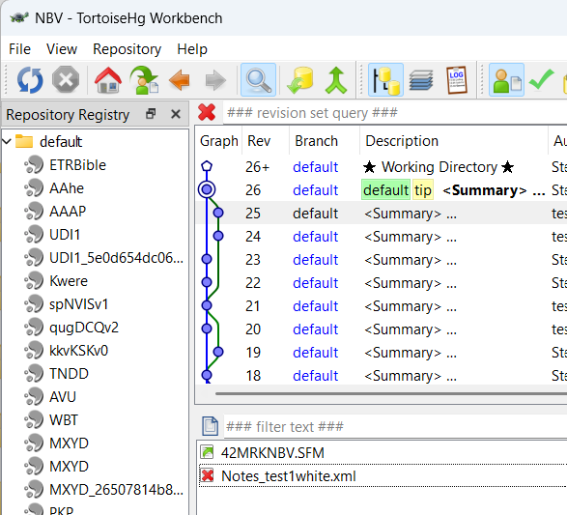
SEGMENT 4 · CUE 4 OF 11
On-screen
a note file deletion visible in recent history.
image-1.png
Notes:
"If the deletion was recent, you can usually spot it directly in the history list, like this."

Slide 27
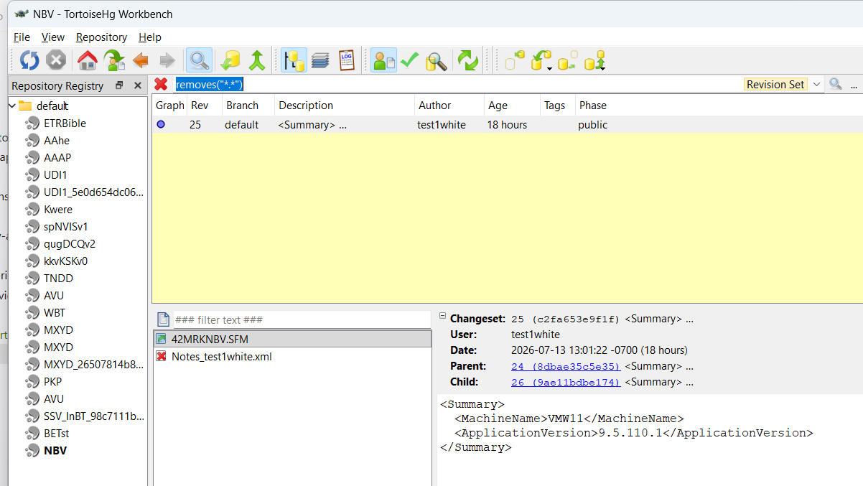
SEGMENT 4 · CUE 5 OF 11
On-screen
the revision-set query box with removes("*.*") entered.
image-3.png
Notes:
"If you can't spot it, search directly: type `removes("*.*")` in the revision set query box — press Ctrl-S if that box isn't showing — and it will find the deletion for you."

Slide 28
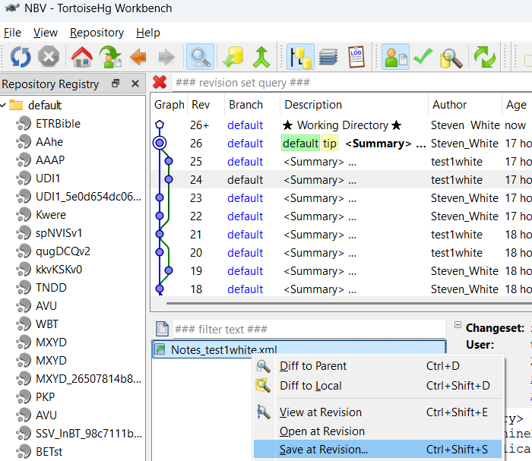
SEGMENT 4 · CUE 6 OF 11
On-screen
right-click the file at the revision before the deletion, choose Save at revision.
image-2.png
Notes:
"Go to the history point just *before* the deletion, right-click the file, and choose Save at revision. Paratext will suggest a filename with an `@` and a version number tacked on."

Slide 29
SEGMENT 4 · CUE 7 OF 11
On-screen
Title card, two columns side by side: Full restore → strip the @NN, keep the original filename. / Merge case → keep the @NN — don't overwrite the current file.
Notes:
"This is the one decision point that matters most. If every note is gone, strip that `@NN` suffix so the file goes back to its original name. If only the *older* notes are gone and recent ones are still showing, you must keep the `@NN` — stripping it here would overwrite the current file and destroy the recent notes you're trying to protect."

Slide 30
SEGMENT 4 · CUE 8 OF 11
On-screen
Title card, numbered: 1) delete first two lines of the new file (<?xml …?> and <CommentList>) 2) delete the last line of the old file (</CommentList>) 3) paste the old content above the new file's remaining content 4) save.
Notes:
"For the merge case specifically: open the new file in a plain text editor and remove its first two lines. Open the old file and remove its last line. Paste the old file's remaining content above what's left of the new file, and save. That stitches the two note histories into one valid file."

Slide 31
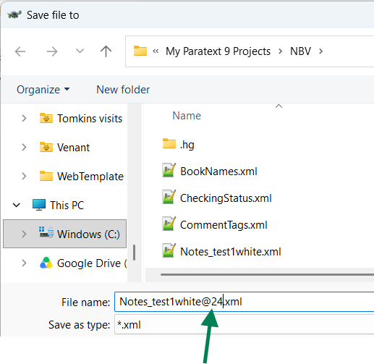
SEGMENT 4 · CUE 9 OF 11
On-screen
Paratext restarted, showing the recovered notes.
image-7.png
Notes:
"Restart Paratext, confirm the notes are back, and do a Send/Receive to circulate them to the rest of the team."

Slide 32
SEGMENT 4 · CUE 10 OF 11
On-screen
WARNING
WARNING title card: If Paratext calls the file corrupt, check three exact lines.
Notes:
"If Paratext instead renames the file `.corrupt`, something went wrong in that edit. Check, in order: the first line must be exactly the XML declaration and appear nowhere else; the second line must be exactly `<CommentList>` and appear nowhere else; the last line must be exactly `</CommentList>` — note the closing slash, which is the only thing distinguishing it from that second line."

Slide 33
SEGMENT 4 · CUE 11 OF 11
On-screen
Title card: Applies to Paratext 9 and 8.
Notes:
"This procedure covers Paratext 9 and 8."

Slide 34
SEGMENT DIVIDER
Segment 5 — Snapshotting an earlier stage into a reference project (companion to Lesson 5)
~3.5 minutes. Two cases again — keep "easy" and "administrator" visually separate, and slow > down for the ordering warning.
5 on-screen cues follow — see subsequent slides for shot list and narration.

Slide 35
SEGMENT 5 · CUE 1 OF 5
On-screen
Title card: Compare Versions lets you look back. Snapshotting gives you a separate project.
Notes:
"Marking milestones and using Compare Versions is fine if all a team wants is to look back at an earlier stage. But some teams want that earlier text as its own standalone project — to print, or to add to a text collection. That's snapshotting."

Slide 36
SEGMENT 5 · CUE 2 OF 5
On-screen
Screen recording, live: New Project → Manage Books → Import Books, selecting books from the main project.
Notes:
"If the team is already at the point they want to preserve, this is the easy case: create a new project, and import the current books straight into it. Nothing else to it."

Slide 37
SEGMENT 5 · CUE 3 OF 5
On-screen
Title card, numbered, matching the six-step lesson procedure: 1) Send/Receive first 2) turn OFF automatic Send/Receive on the main project 3) Revert books to the chosen history point 4) create the new project and import the reverted books 5) Delete project → Delete from this computer only 6) Send/Receive to restore the current main project, then re-enable automatic Send/Receive.
Notes:
"If you need an *earlier* point — not where the project is now — an administrator does this instead: Send/Receive any pending work, turn off automatic Send/Receive, revert the books to the history point you want, import them into the new project, delete the reverted copy of the main project — **from this computer only** — and then Send/Receive to bring the main project back to its current state."

Slide 38
SEGMENT 5 · CUE 4 OF 5
On-screen
DANGER
DANGER title card: Never Send/Receive between the revert and the delete.
Notes:
"Say this part precisely: between step 3, reverting the books, and step 5, deleting that reverted copy, the main project sits locally reverted to an old state. If a Send/Receive — automatic or manual — happens anywhere in that window, it pushes the old, reverted text out to the whole team as if it were new work, overwriting everyone else's more recent edits. That's exactly why automatic Send/Receive gets turned off first, and why the reverted copy gets deleted with 'this computer only,' never sent anywhere."

Slide 39
SEGMENT 5 · CUE 5 OF 5
On-screen
Title card: Applies to Paratext 9.
Notes:
"This procedure is scoped to Paratext 9."

Slide 40
CALL TO ACTION / CLOSE
Five Calls, Five Fixes
~60 seconds.
Simple closing slide listing the five topics in scenario-bank order: Open-source text → History illusion → Suspicious edit → Archived draft → Vanishing notes.
Notes:
Five different support calls, five different fixes — but the same
underlying discipline: figure out what actually happened before you act, and know which
of these situations has a wrong first move that makes things worse. Now it's your turn.
Open the scenario bank and work through all five scenarios — they're sequenced from
straightforward to most involved, and the last one will have you actually running
TortoiseHG yourself. Write out your diagnosis and your step-by-step plan for each one,
and submit your answers to your mentor for feedback before you take the quiz.

Slide 41
APPENDIX
Notes for the Presenter
• Two segments carry real destructive-procedure risk — narrate them precisely, don't paraphrase from memory. Segment 3's "do not Send/Receive, delete and resync instead" and Segment 5's revert-then-delete ordering are the two places in this course where getting the sequence wrong on camera would teach the *opposite* of the safe procedure. Read from the lesson text for those two step lists rather than ad-libbing the order.
• On production status of this content: 00-design.md's SME knowledge notes record that the procedural gaps originally flagged for Scenario 3 (user roles) and Scenario 5 (reference-project snapshotting) — missing version scope and "what good looks like" criteria — were filled by the SME before the lesson content was drafted, and both lessons now carry full version scope and success criteria. No hedging language is needed in the delivery for those two topics on that basis. Do note, separately, that the design doc's SME-consulted field still reads "TBD" at the top of the document even though the detailed interview notes further down are complete — that looks like a stale summary line in 00-design.md rather than an open procedural gap; flag it to the course lead if it should be corrected, but it isn't a reason to soften this script.
• Terms to define on screen, not just say: "resource" vs. "project" (Segment 1), "version number" vs. "chronological order" (Segment 2), "observer" role (Segment 3), and the @NN filename suffix (Segment 4) — these are the exact words learners will need to use correctly when they explain these situations to non-technical users. Segment 4's two-column "strip the suffix / keep the suffix" card is the single most important visual in the whole video — hold it on screen a beat longer than feels natural.
• Live-demo caution — Segment 4 and Segment 5. If recording any of the delete-project or revert-books actions live rather than on a title card, do it against a disposable test project, never a real team's project. The lesson's own screenshots (image-1.png through image-7.png in this module folder) were captured from a test project built for this purpose — reuse them as static cues rather than re-recording the TortoiseHG steps live unless a fresh recording is specifically wanted.
• Confirm menu paths against the current Paratext 9 build before recording. The lessons name exact menu sequences (e.g., "Manage Books → Import Books," "Delete project" with a "Delete from this computer only" option). These are accurate as of the SME's account behind the lesson content, but menu wording can drift across minor Paratext 9 point releases — do a quick pass in the actual installed version being recorded and flag any mismatch to the lesson author rather than quietly changing the script's wording on the fly.
• Pacing. This script runs long for a support-procedure video because two of the five topics (Segments 3 and 5) hinge on getting a sequence of steps exactly right, and one (Segment 4) has real sub-branches. Resist compressing Segments 3, 4, or 5 to make the runtime shorter — if the video needs to be shorter, cut Segment 1 (the lowest-stakes topic) down to its title cards only, not the higher-risk segments.
• Do not invent additional detail live. Everything in this script is drawn directly from Lessons 1-5 and the scenario bank; if a presenter's question comes up during recording that isn't answered in the lesson content (e.g., a Paratext version not covered, or a step for a scenario this course doesn't include), take it to the course lead rather than answering it on camera.
Notes:
Presenter guidance — not narration. Review before recording; do not read this slide aloud.

